Slide 1

WordpRess
A refresher and what’s new overview for libraries
Mark Beatty
mbeatty@wils.wisc.edu
April 11, 2013

Slide 2
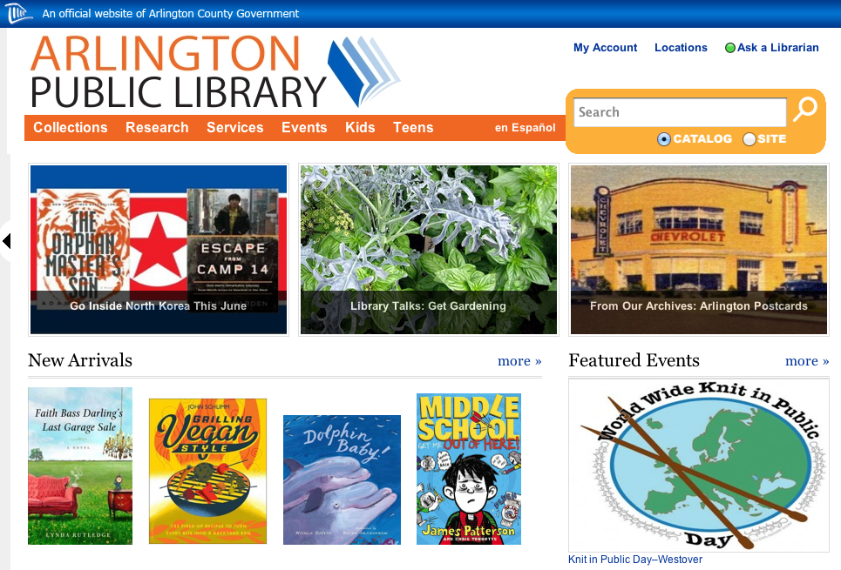
Sample Sites
South Wood County Historical Museum
  http://www.swch-museum.com
Arlington VA
  http://library.arlingtonva.us/
Topeka & Shawnee County PL
  http://tscpl.org
Demo Library
  http://www.wilsorama.org/demolibrary/
Waterford Library *
  http://www.waterford.lib.wi.us/
SWLS
  http://swls.wordpress.com/
  * transitioned in 30 days

Slide 3

Why WordPress
Easy to use and update
Dynamic
Looks terrific
Interoperability
Spend your time communicating with your patrons
  Not writing code
http://wordpress.org/
http://wordpress.com/

Slide 4

Hosting
Your own solution, get installer from WordPress.org
  Local Government
  Campus
  Who’s doing it now
WiscNet
  https://www.wiscnet.net
Commerical options
  Bluehost
    http://www.bluehost.com/
  DreamHost
    http://dreamhost.com/
  1and1
    http://www.1and1.com/
WordPress.com
  http://wordpress.com/

Slide 5
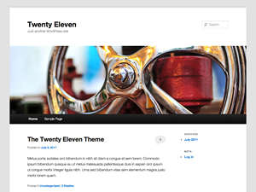
Themes
Your public face
Your physical organization
Your style
Your content organization
Navigation
Instant change for a whole new look
Responsive designs now available
http://wordpress.org/extend/themes/
http://theme.wordpress.com

Slide 6

Static v. Dynamic content
Pages are Static
  How to’s
  Location
  Contacts
  Calendars
  Web forms
Posts are Dynamic
  Events
  Announcements
  Readers alerts

Slide 7

Widgets
Side bar and footer blocks
Header bar, provides branding and navigation*
Persistent information on every page
  Search your OPAC
  RSS Feeds
  Social links
  Basic Extended navigation
  * not really a “widget” but still a visual extra content block and in some themes can add widgets to the header area

Slide 8

Interoperability
Google extensions like
  http://www.google.com/intl/en/about/products/
  Calendar
  Maps
  Docs to Web Forms
Library Thing or Good Reads
  http://www.librarything.com/
Open Book
  http://openlibrary.org/
RSS feeds and subscriptions
  http://www.wisconsinhistory.org/syndicate.asp
  http://wordpress.org/extend/plugins/mailchimp/
Engaged Patrons
  http://engagedpatrons.org/

Slide 9

Plug ins
Akismet – Spam Control
Easy Rotator for WP – plus a desktop app – Slideshows
Image Widget – graphics in widgets
Open Book – insert book covers and data
Sharing is Caring – links to social media on pages and posts – Users repost Your content to Their social
Subscribe/Connect/Follow Widget – social links widget – Your social sites delivered to Users

Slide 10
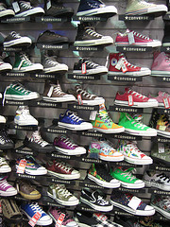
New and Cool
Easy Rotator – Slide shows anywhere
Custom Sidebars – page by page control
All in one Event Calendar
WP Super Cache
Responsive Themes – looks great no matter what device the patron is using
  Need to consider some fixed width thingies, like pictures

Slide 11
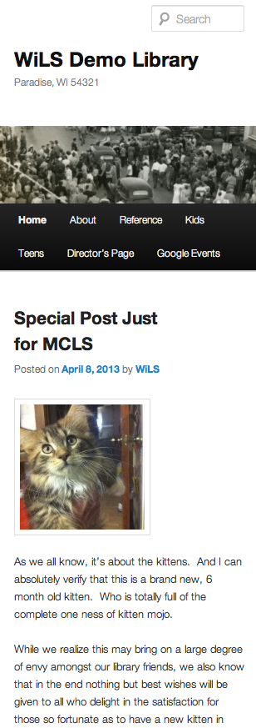
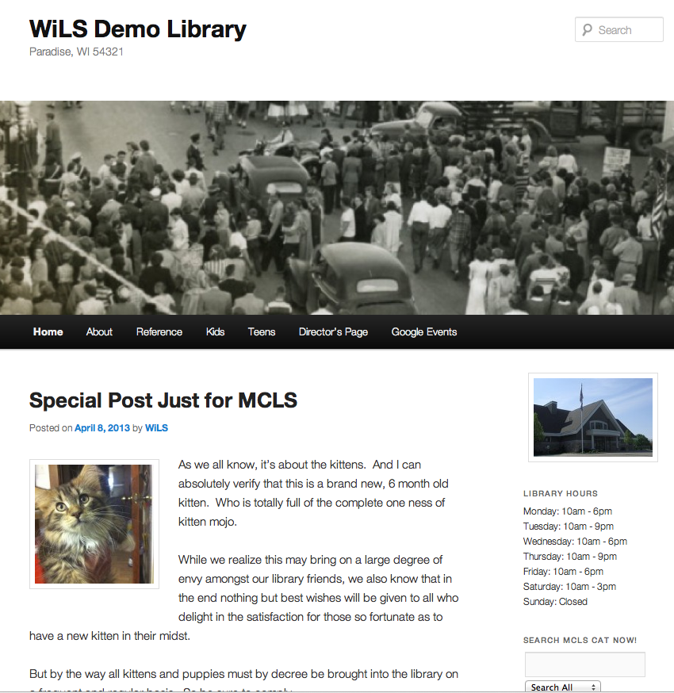
Responsive Themes
2011
Responsive
Catch Box
Suffusion
Business lite

Slide 12
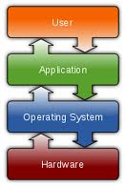
Operating
Get your people organized
Dynamic site so want dynamic people contributing
Assign user levels
  Easy to contribute
  Don’t mess up others stuff
Front page is what’s new, keep it so
  Remember it’s easy to do

Slide 13

Go do it!
Start up can be fast
Content population can be easy
Adding and deleting resources is easy
Changing entire look is easy
It’s dynamic so…
Don’t worry about perfect, especially day one
Concentrate on making it better and better and more useful every day
Your website can be a conversation between you and your patrons

Slide 14
WordpRess
A refresher and what’s new overview for libraries
Mark Beatty
mbeatty@wils.wisc.edu
April 11, 2013

